Slide 1
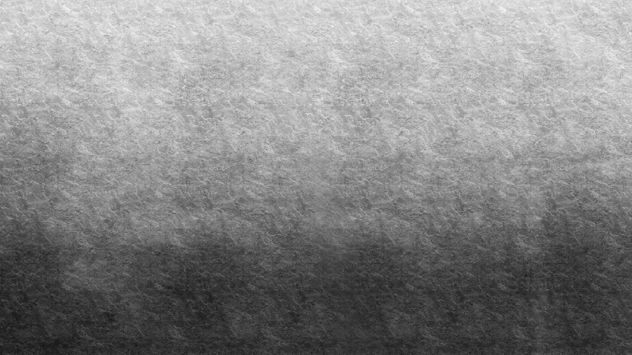
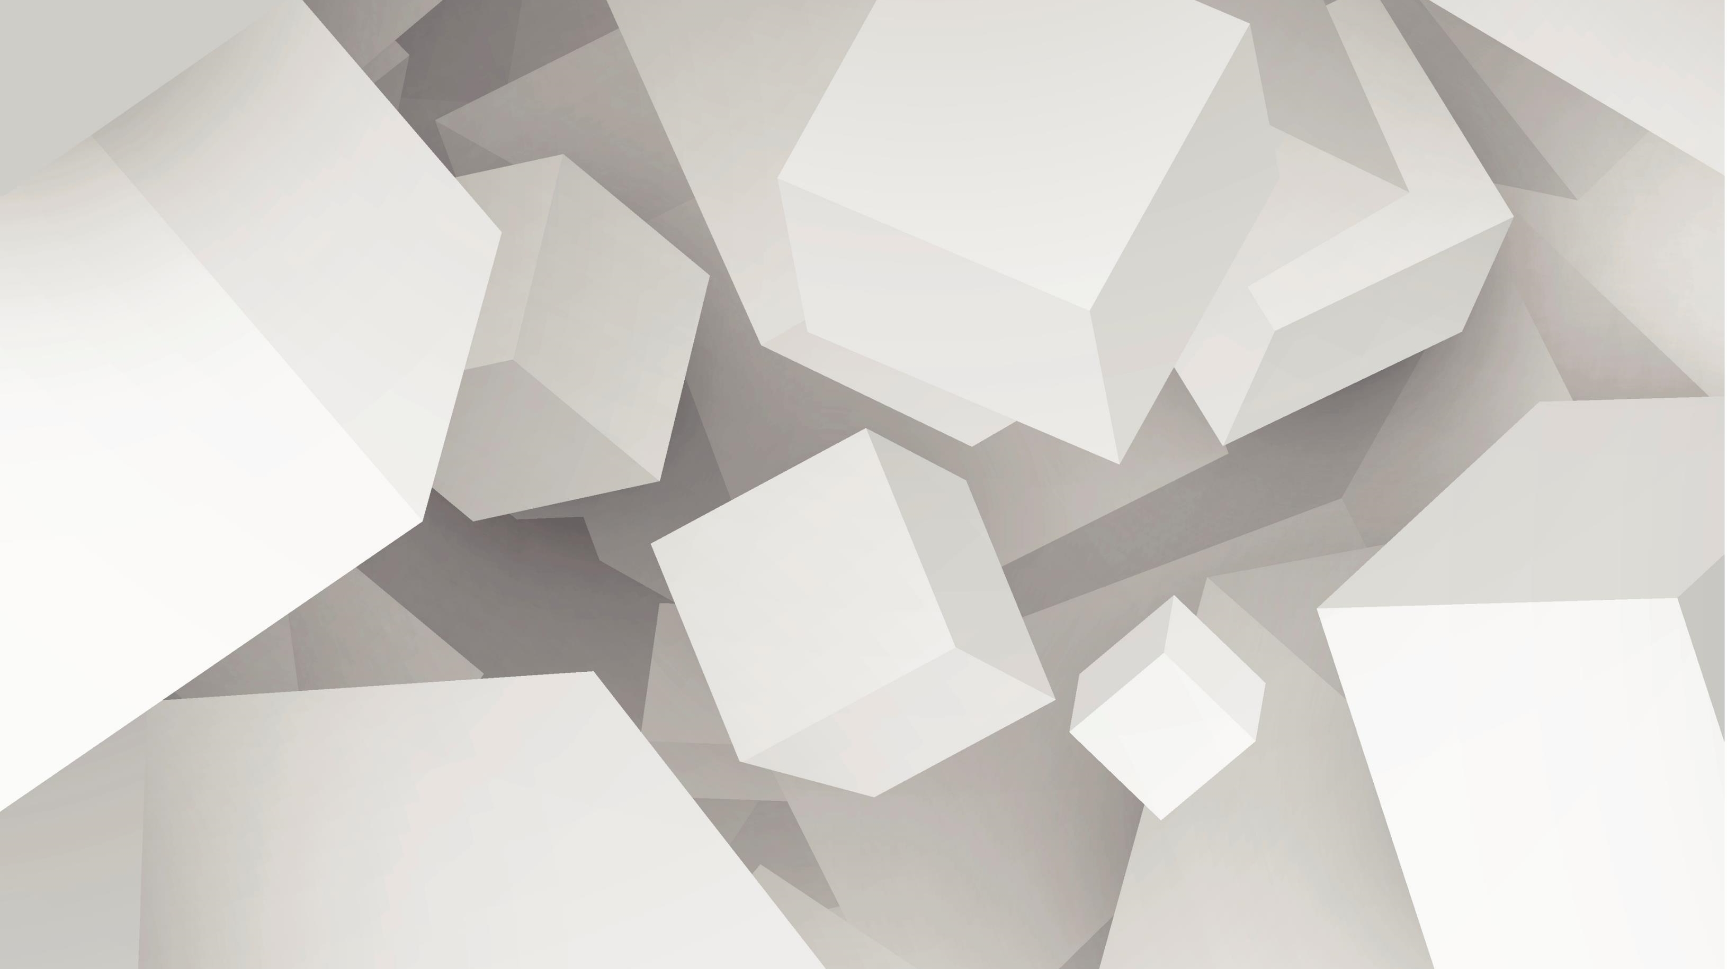
Neural Super Sampling
Bhuvan Aggarwal 190040026
Punit Madia 190100096
Nageswar Venkata Sai Gangadhar 190100080

Slide 2
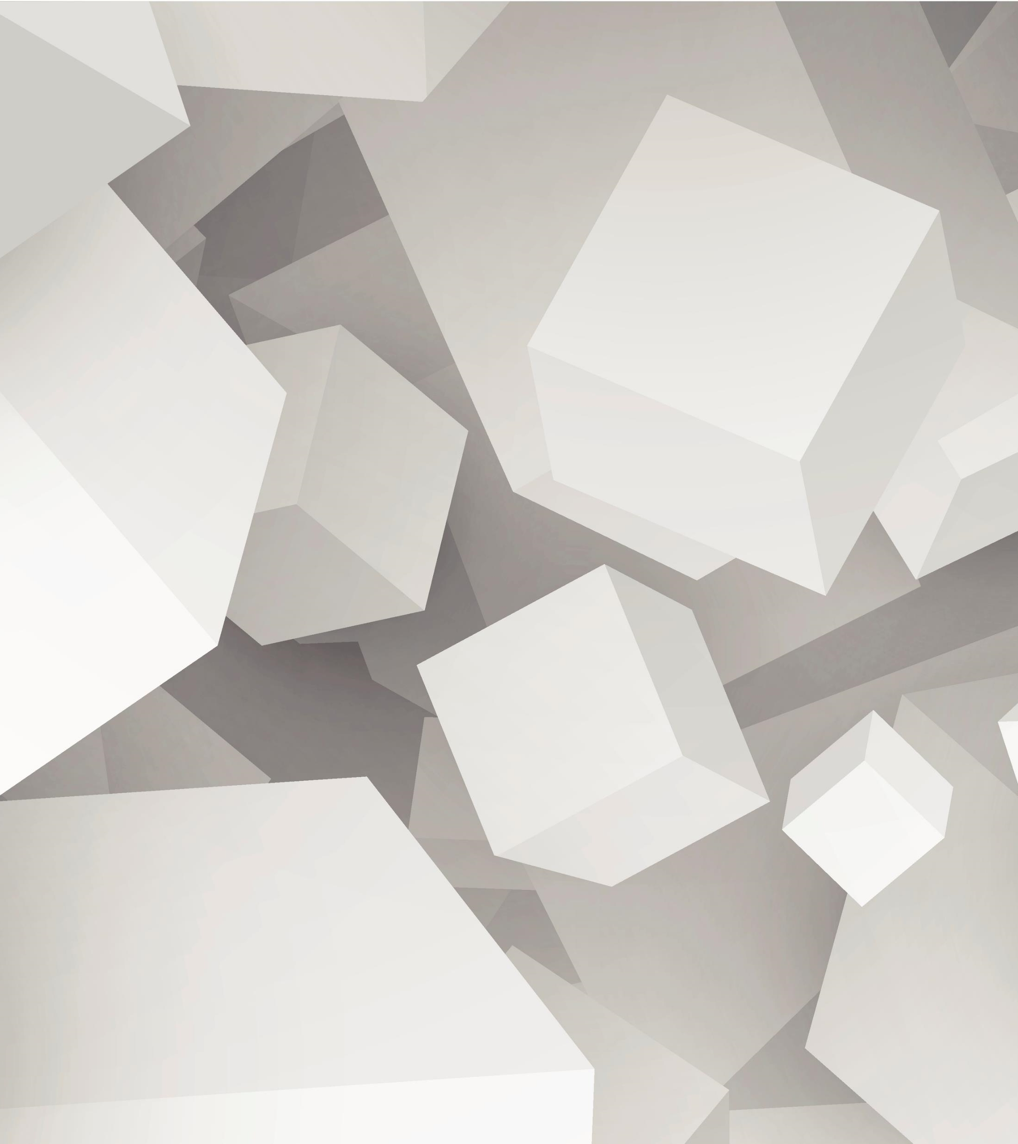
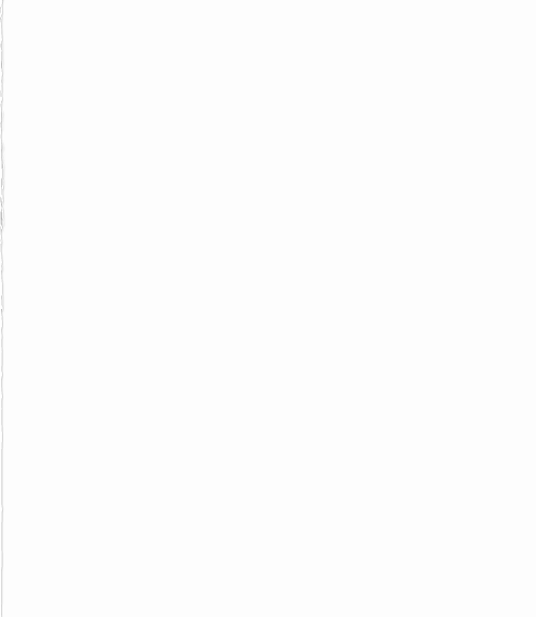
Problem Statement
Given an RGB image, we upscale the image by a factor of 4 i.e. image of size (24 X 24) would be scaled to size of (96 X 96).

Slide 3
Workable Solutions
Interpolation
Auto Encoder
GAN
cv2.resize()
Interpolation type = cv2.INTER_LINEAR
Blurriness is caused to the up sampled image
Decoder can be used for Up sampling
Good for Upscaling factor of 2
Not efficient for a factor of 4 or more.
Poor quality images are obtained.
LR image is feed to the Generator
Output of Generator is HR image
Works excellent in most of the Up sampling cases.

Slide 4
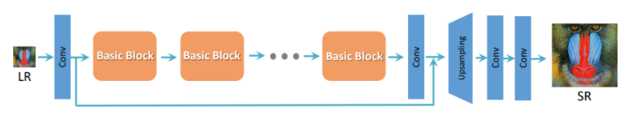
SRGAN – THE GAN APPROACH
Based on the Paper – “Using GANs for Single Image Super-Resolution”
Basic structure includes Residual block and then upscaling is done.

Slide 5
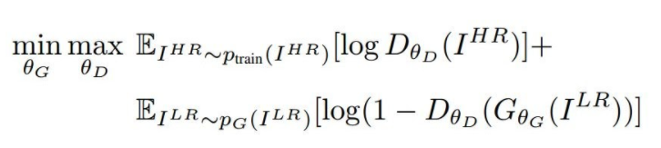
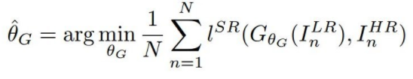
Generator
Discriminator
G: generator that takes a low-res image I^{SR}
θ_{G}: parameters of G, { W_{1:L}, b_{1:L} }
l^{SR} : loss function measures the difference between the 2 high-res image
D: discriminator that classifies whether a high high-res image is I^{HR} or I^{SR}
θ_{D}: parameters of D

Slide 6
Details of the Training - SRGAN
Training dataset consisted of 8144 images. LR images were created using resizing the image using interpolation techniques - cv2.INTER_CUBIC in OpenCV
Number of Epochs – 2000
Loss – Binary Cross Entropy
Optimizer – rmsprop
Framework – Keras with Tensorflow as backend

Slide 7
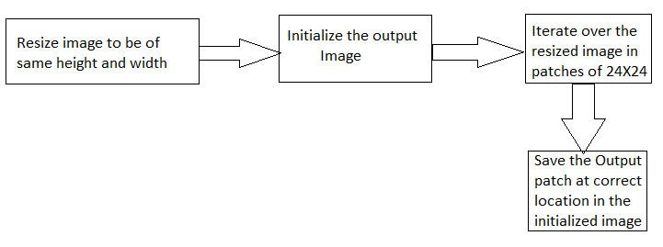

Testing Algorithm

Slide 8
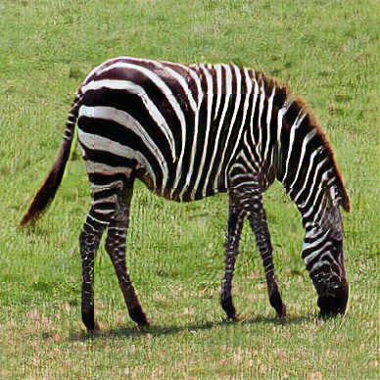
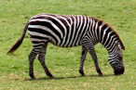
Results
LR
146 ✕ 97
HR
388 ✕ 388

Slide 9
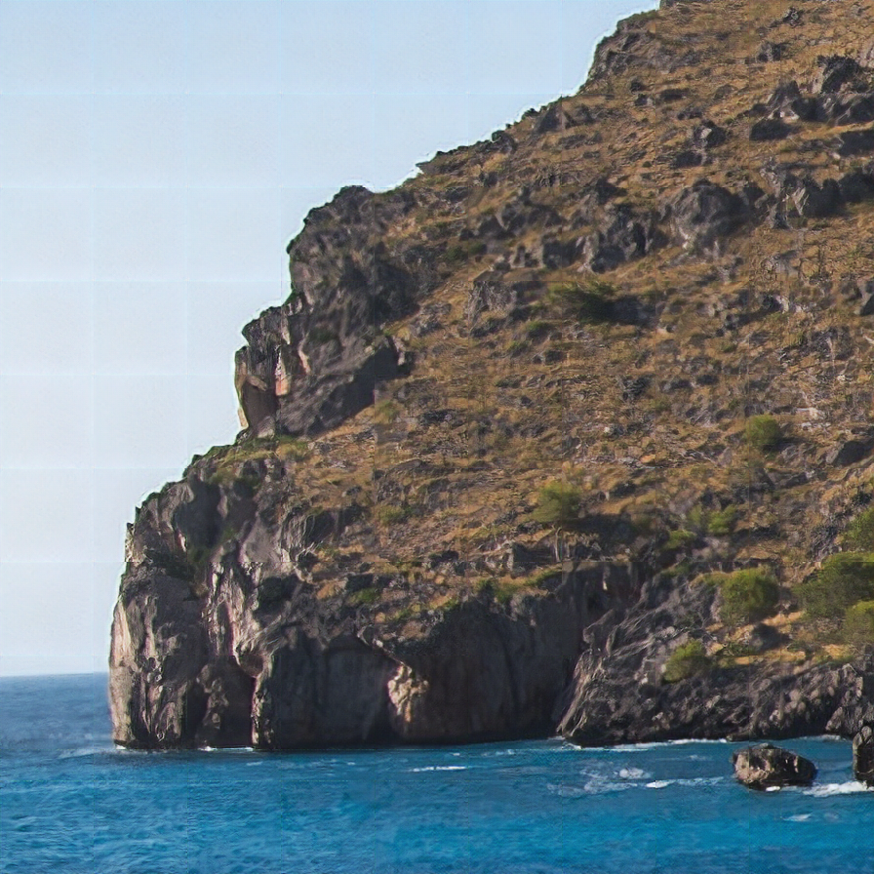
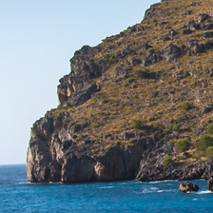
LR
224 ✕ 224
HR
896 ✕ 896

Slide 10
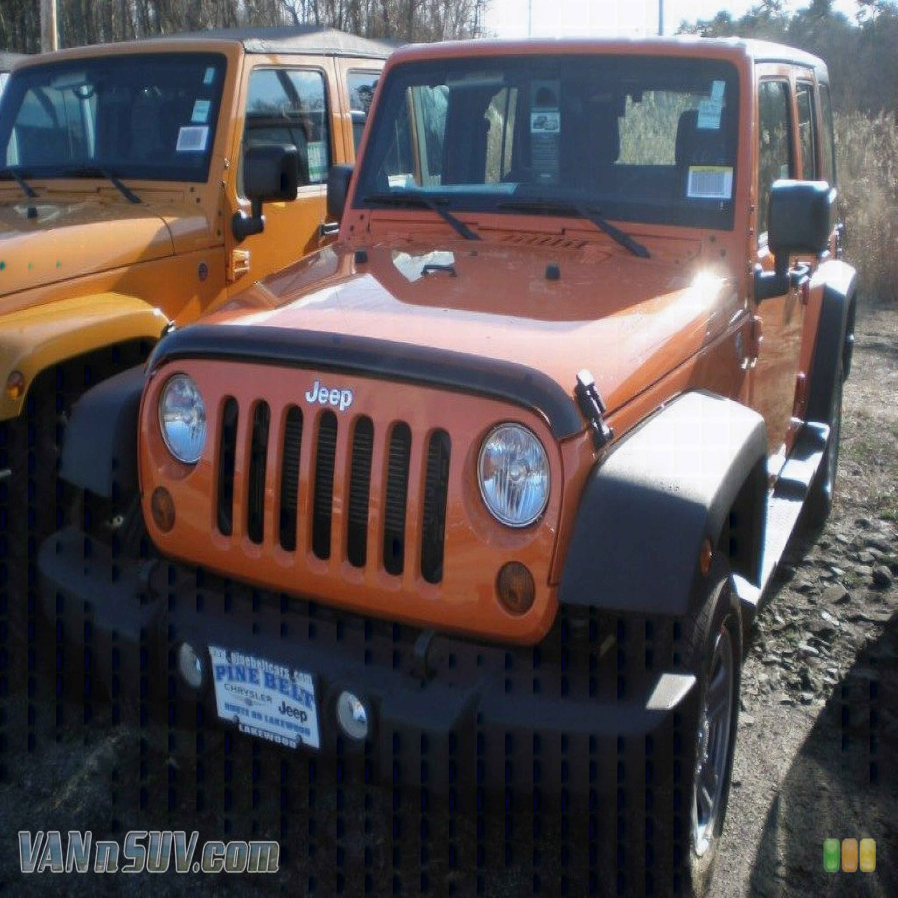

LR
1024 ✕ 768
HR
3072 ✕ 3072

Slide 11
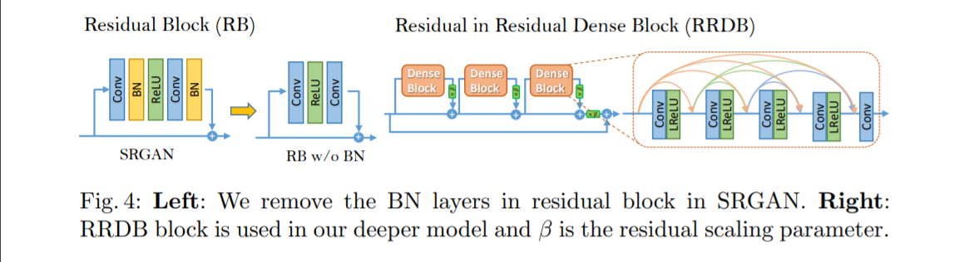
Improved SRGAN
In order to further improve the recovered image quality of SRGAN, we mainly make two modifications to the structure of generator G: 1) remove all BN layers; 2) replace the original basic block with the proposed Residual-in-Residual Dense Block (RRDB), which combines multi-level residual network and dense connections as depicted in Fig.

Slide 12
Details of Training – Improved SRGAN
Training dataset consisted of 8144 images. LR images were created using resizing the image using interpolation techniques - cv2.INTER_CUBIC in OpenCV
Number of Epochs – 2200
Loss – Binary Cross Entropy
Optimizer – rmsprop
Framework – Keras with tensorflow as backend

Slide 13
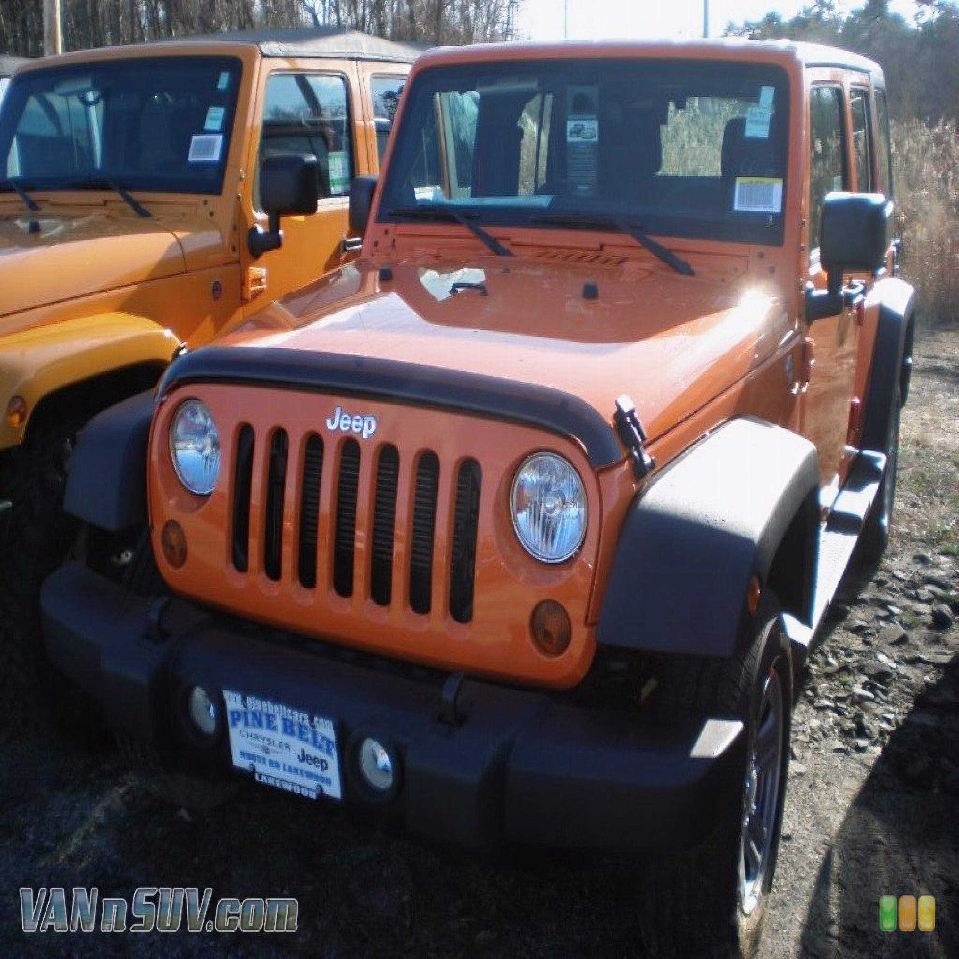
LR
1024 ✕ 768
HR
3072 ✕ 3072

Slide 14
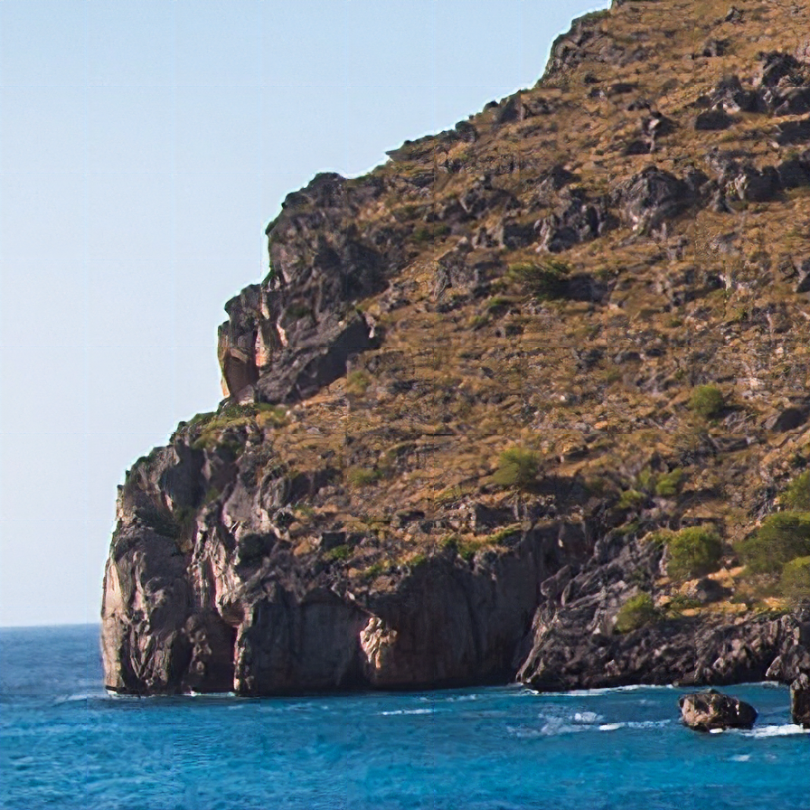
LR
224 ✕ 224
HR
896 ✕ 896

Slide 15
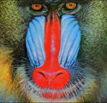
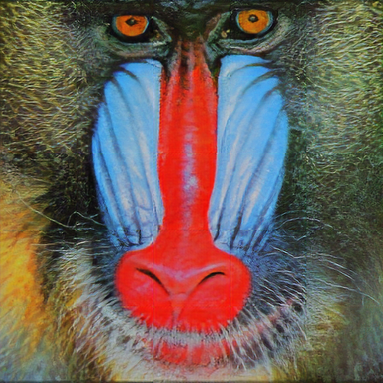
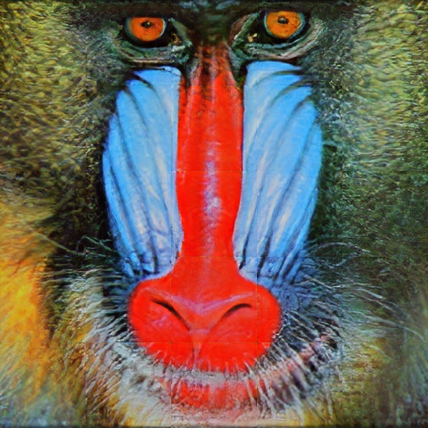
SRGAN
Improved SRGAN (ESRGAN)

Slide 16
References
SRGAN Paper - https://arxiv.org/abs/1609.04802
ESRGAN Paper - https://arxiv.org/abs/1809.00219

Slide 17
RUN INSTRUCTIONS
Upload your Low resolution image in SRGAN/test/input and high resolution output will be generated in SRGAN/test/output (similar procedure goes for ESRGAN)
Start training: python train.py
For testing: python test.py
model.py consists of the SRGAN model code
.ipynb notebooks are also present for ease of access.

Slide 18
Thank You!

